Slide 1

Uniswap Address Analysis
Tapping into the DeFi Goldmine for Strategic Investments
July 28th, 2023
28.07.2023

Slide 2
:
Why Decentralized Finance (DeFi) ?
Relevance
Projected DeFi growth: 46.0% CAGR from 2023 to 2030 (market valued at USD 13.61 billion in 2022) (source)
Large trades erode profits: a niche for smaller investors
30% institutional adoption: a vast, untapped market. (source)
Vision
Strategically position in the growing DeFi ecosystem
Anticipate market shifts by understanding investor types
Notes:
Large institutional trades in the DeFi space can shift market prices, eroding profit margins. In contrast, smaller trades, less impactful on market dynamics, preserve potential returns, making DeFi a goldmine for smaller players.
By recognizing different types of investors and traders, we get a holistic view of the decentralized exchange ecosystem.Anticipate market shifts, ensuring our investment strategies are always one step ahead

Slide 3
A Primer on Ethereum, DeFi & DEXES
Ethereum
DeFi
DEXES
Pioneering blockchain for fully automated, decentralized applications (DApps)
ETH: System's fuel
75% of DApp Value (TVL & Volume) on Ethereum
Financial services via DApps: trading, lending, staking
Focus on Tokens, not Cryptocurrencies
Biggest DApps: Uniswap, AAVE, Lido
Peer-to-peer trading without middlemen
Automated market-making: transactions and actors automatically & anonymously stored on the ethereum blockchain
Uniswap: DeFi's dominant player DEX

Slide 4
Uniswap Address Analysis
The Capstone Project
Objective
Identifying and grouping together key players based on patterns in their Uniswap transaction activity
Pinpointing potential investment opportunities and risks by analyzing their token holdings and investment/trading strategies
Challenge
The DEX Maze
Large amount of data: AMMs produce vast, daily transaction data, making traditional analysis unfeasible
Decentralized Complexity: Without centralized order books, data is dispersed across the blockchain, and automated transactions further obscure patterns
Approach
Unique address identification and traceability via Etherscan website
EDA and unsupervised machine learning for clustering key players
Relying on Dune Analytics (most reputable data indexer) for Uniswap transaction data covering the largest crypto bull run (2020-2022) in history
Notes:
box 1:
This isn't about predicting individual moves but understanding overarching types of investors/traders (clusters)
box 3:
even though anonymous, actors are uniquely identifiable by their addresses and manually traceable on reputable websites (Etherscan)
Harness EDA, unsupervised machine learning and Etherscan to cluster Uniswap transaction data during the biggest crypto bull run (January 2020 until October 2022) into key main players
Rely on Dune Analytics (most reputable data indexer)

Slide 5
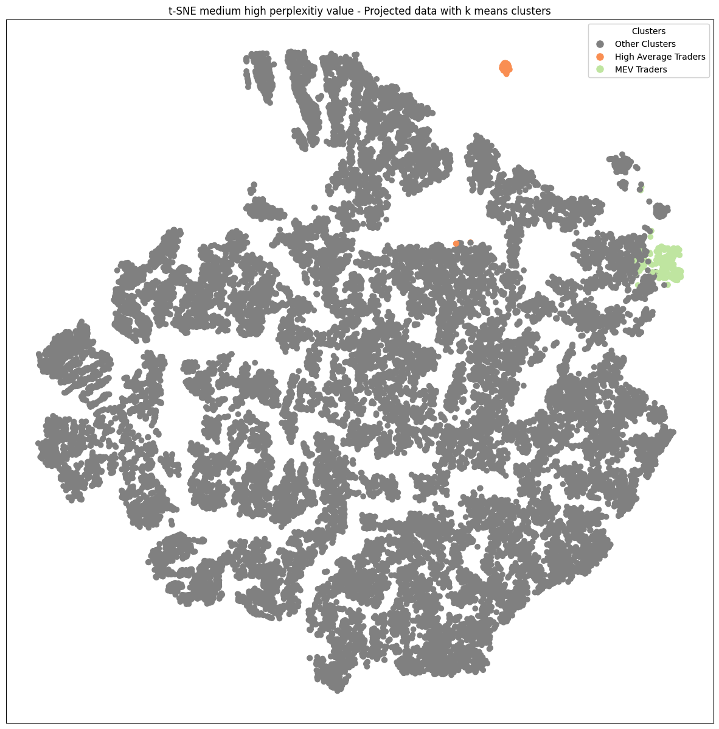
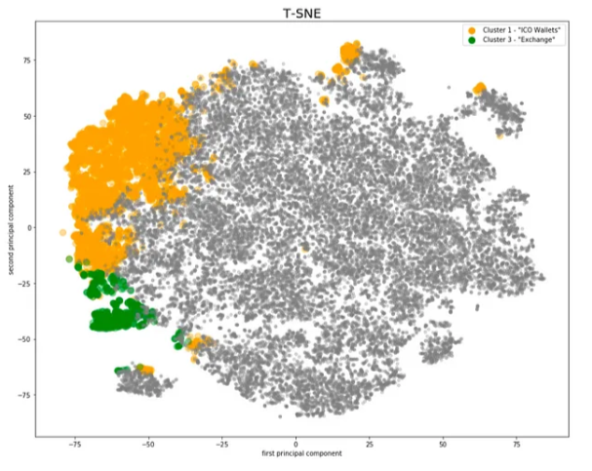
Two Distinct Uniswap Archetypes
Clustering Uniswap Addresses (2020-2022)
Industry Benchmark: Clustering Ethereum Addresses (2019)
Notes:
Breaking down our high dimensional data into 2-D, and use our k-means clustering
Assumption Our clustering is based on patterns in transaction activity, a proven method as seen in similar projects like the one on "Clustering Ethereum Addresses". This gives us a reliable foundation to identify key players.
both projects used the same methods k means for clustering, tsne for 2 d visualization of high dimensional data

Slide 6
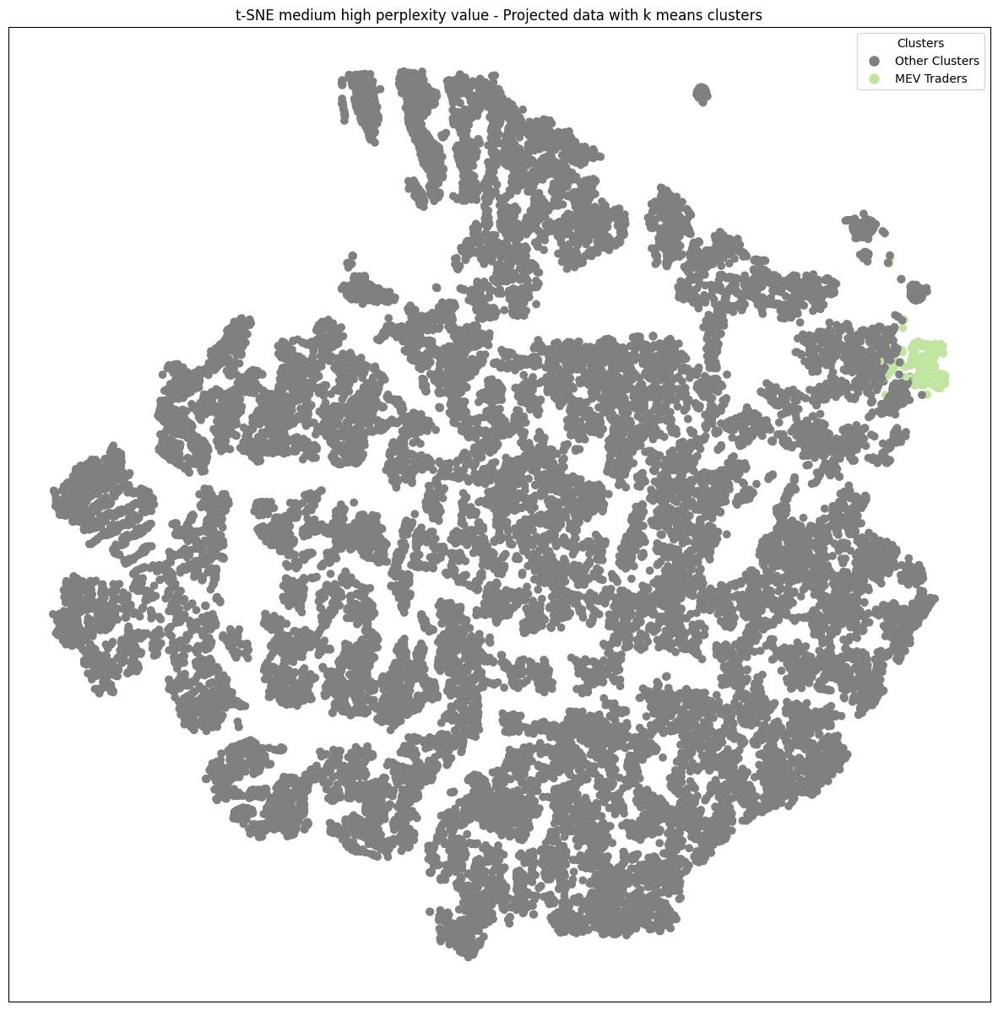
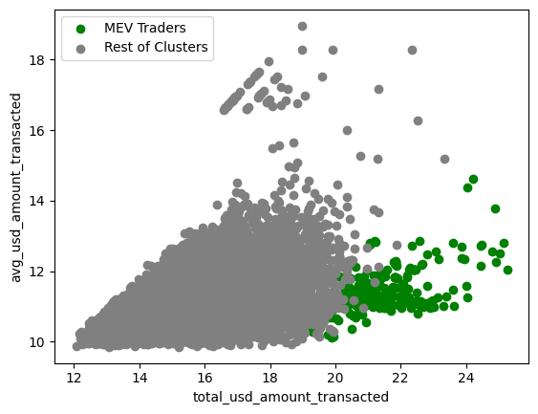
MEV Cluster: High Value, Low Quantity
Notes:
Breaking down our high dimensional data into 2-D, and use our k-means clustering
Assumption Our clustering is based on patterns in transaction activity, a proven method as seen in similar projects like the one on "Clustering Ethereum Addresses". This gives us a reliable foundation to identify key players.
both projects used the same methods k means for clustering, tsne for 2 d visualization of high dimensional data

Slide 7
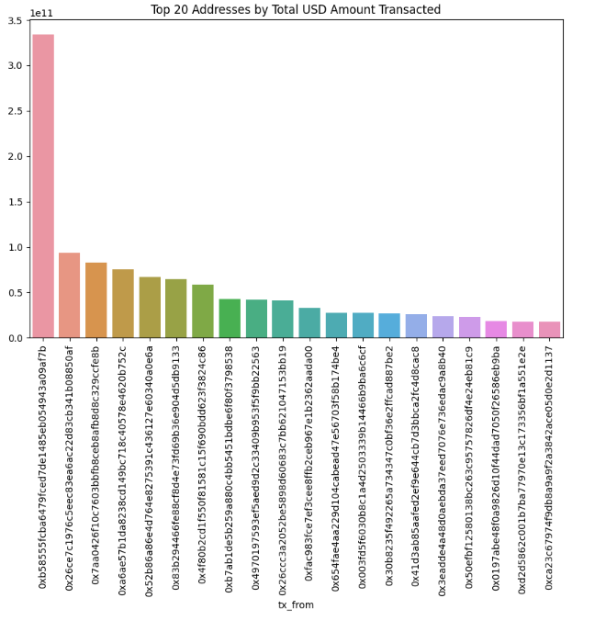
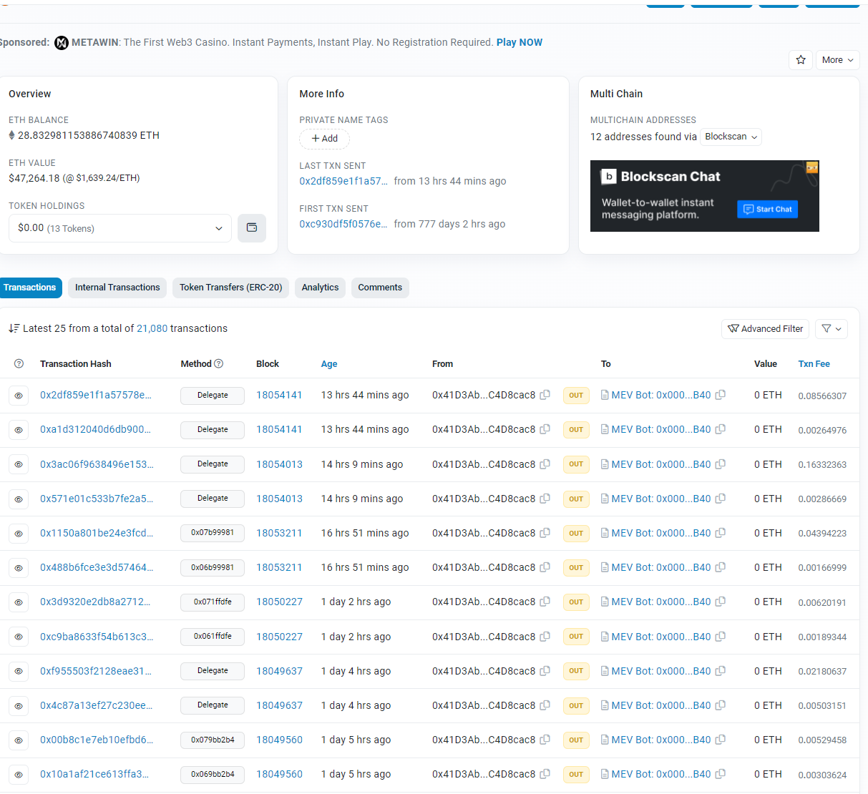
The tokens bought by MEV actors should be avoided due their nature (front running)

Slide 8
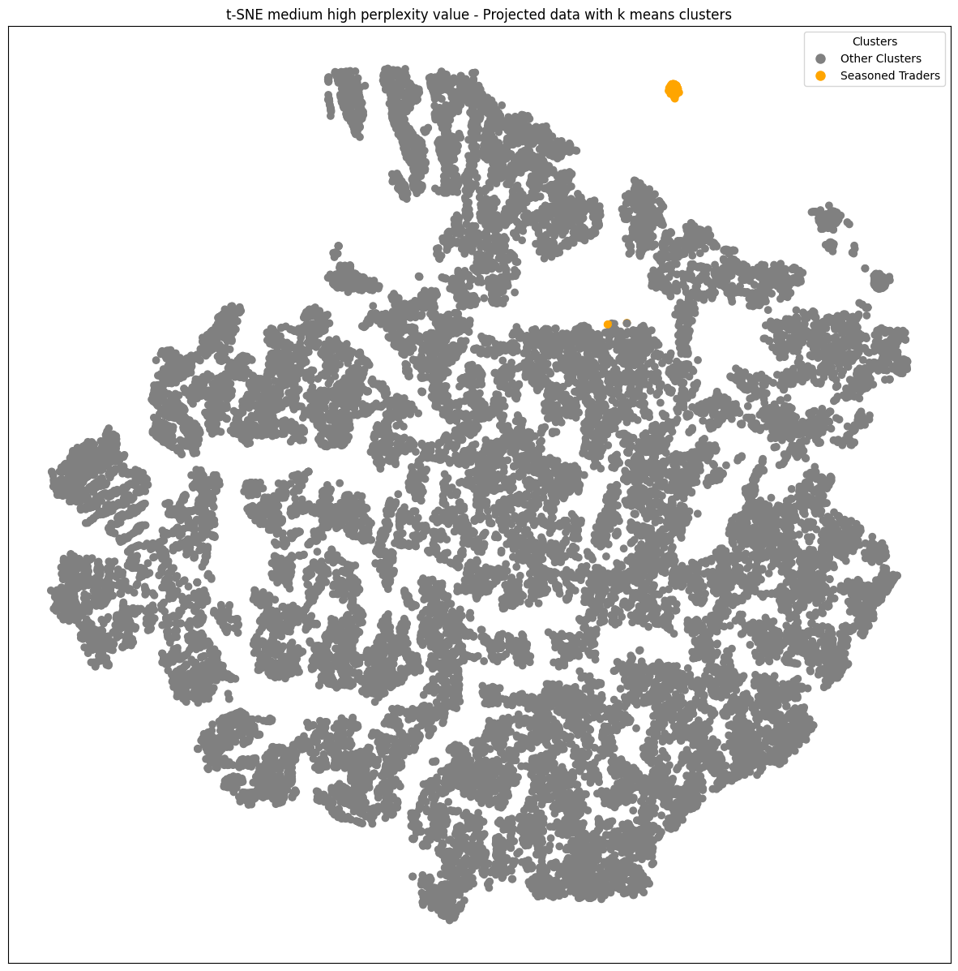
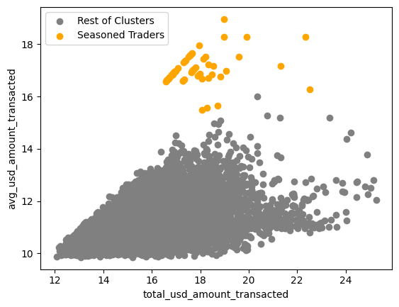
Seasoned Traders: Medium Value, High Quantity
Notes:
Breaking down our high dimensional data into 2-D, and use our k-means clustering
Assumption Our clustering is based on patterns in transaction activity, a proven method as seen in similar projects like the one on "Clustering Ethereum Addresses". This gives us a reliable foundation to identify key players.
both projects used the same methods k means for clustering, tsne for 2 d visualization of high dimensional data

Slide 9
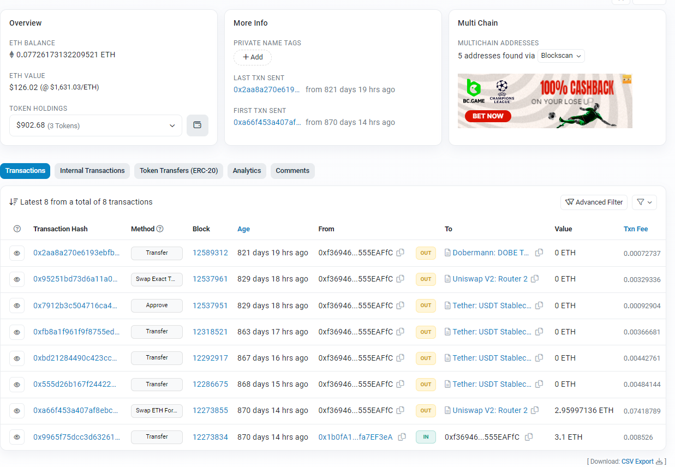
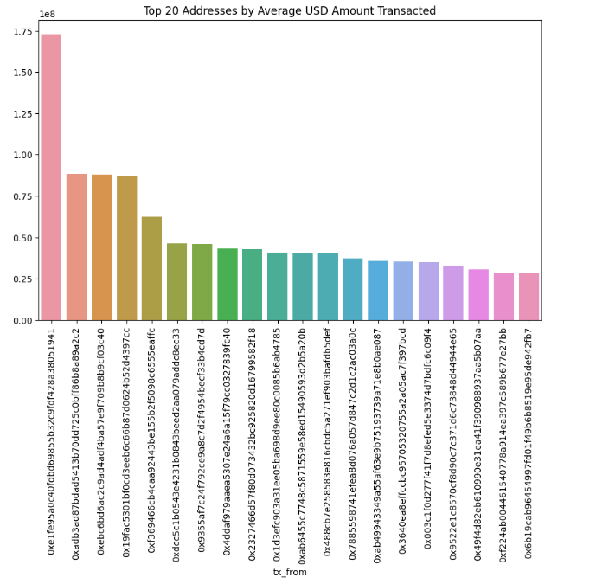
Token Holding Insights from Seasoned Traders

Slide 10
The road ahead
Next steps
Dissect MEV clusters for activist investors?
Analyze seasoned trader token holdings
Model trading behavior using graph theory & network analysis
Risks
Dynamic digital asset space
Complex ecosystem interdependencies
Data quality concerns
Notes:
Large institutional trades in the DeFi space can shift market prices, eroding profit margins. In contrast, smaller trades, less impactful on market dynamics, preserve potential returns, making DeFi a goldmine for smaller players.
By recognizing different types of investors and traders, we get a holistic view of the decentralized exchange ecosystem.Anticipate market shifts, ensuring our investment strategies are always one step ahead

Slide 11


Background & Contact
Cedric Vogt
BA Economics, Msc in Management
Former business analyst in FinTech
Transitioned into DeFi development & analysis
📱+ 41793832395
📧 cedricvogt91@gmail.com
in/cédric-vogt

Slide 12
Appendix

Slide 13
Features
tx_from | tx_count | distinct_token_count_in_txs | total_usd_amount_transacted | avg_usd_amount_transacted | active_months | monthly_txns_count | monthly_usd_amount_transacted
0xb58555fcba6479fced7de1485eb054943a09af7b | 585248.00 | 565 | 333885754023.44 | 570503.02 | 17 | 34426 | 19640338471.97
0x26ce7c1976c5eec83ea6ac22d83cb341b08850af | 544010.00 | 1114 | 93413356007.42 | 171712.57 | 19 | 28632 | 4916492421.44
0x7aa0426f10c7603bbfb8ceb8afb8d8c329ccfe8b | 225383.00 | 385 | 82797756346.90 | 367364.69 | 16 | 14086 | 5174859771.68
0xa6ae57b1da8238cd149bc718c40578e4620b752c | 282253.00 | 871 | 75558529891.35 | 267697.88 | 19 | 14855 | 3976764731.12
0x52b86a86e4d764e8275391c436127e60340a0e6a | 320112.00 | 530 | 67199860810.47 | 209926.09 | 16 | 20007 | 4199991300.65

Slide 14
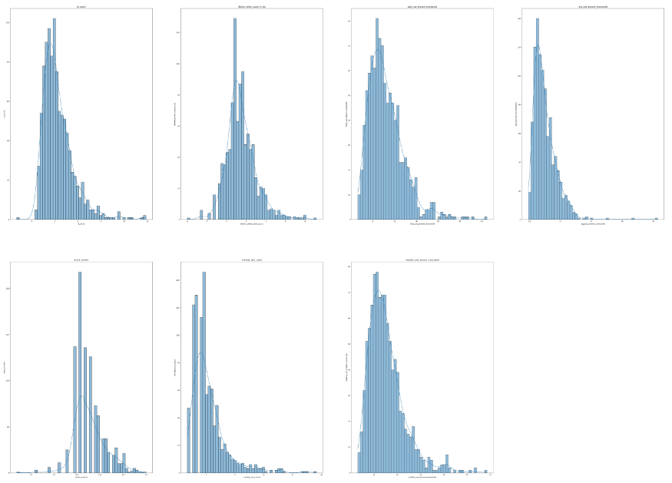
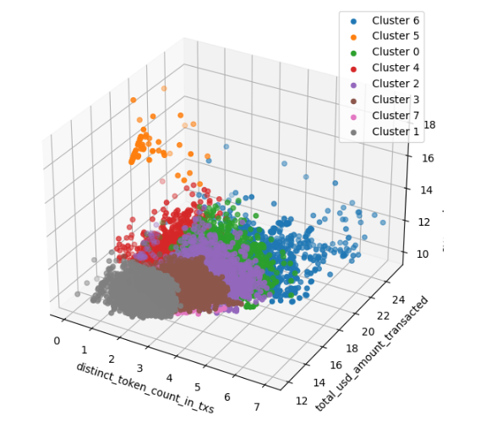
Uniswap Log Subsample: Non-amateur Traders

Slide 15
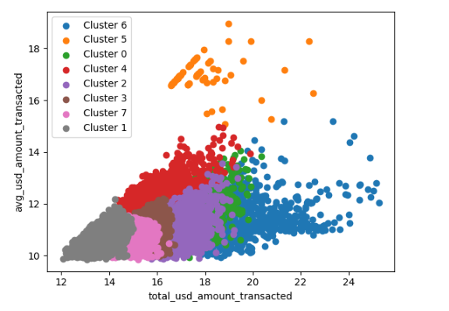
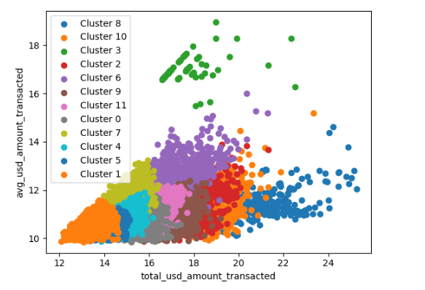
Recommended Clusters: 8 or 12

Slide 16
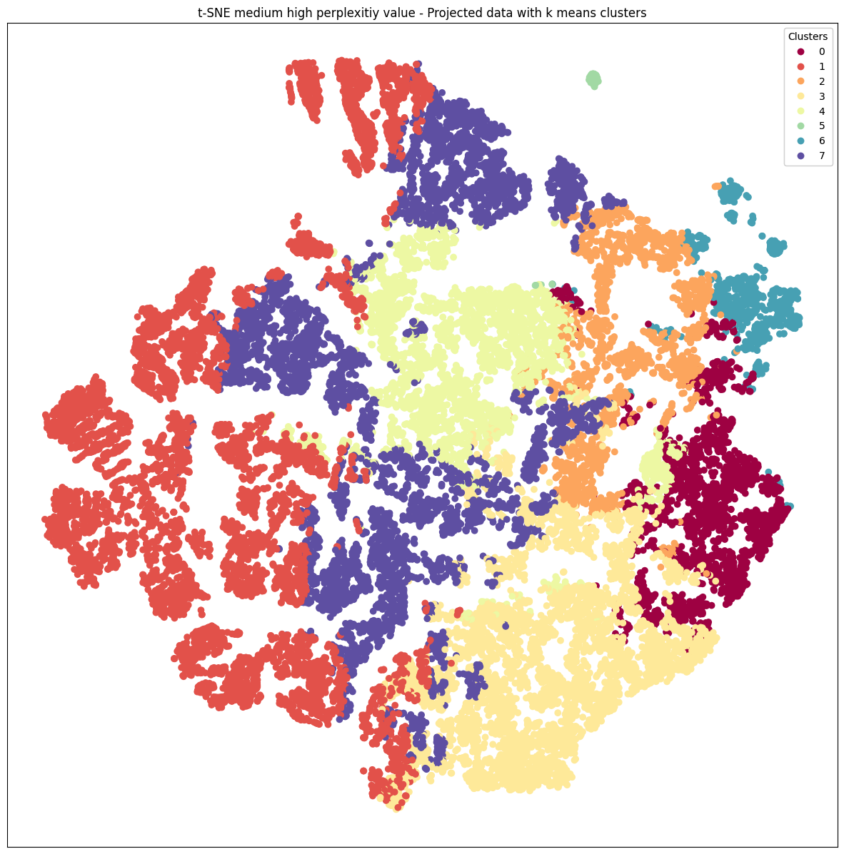
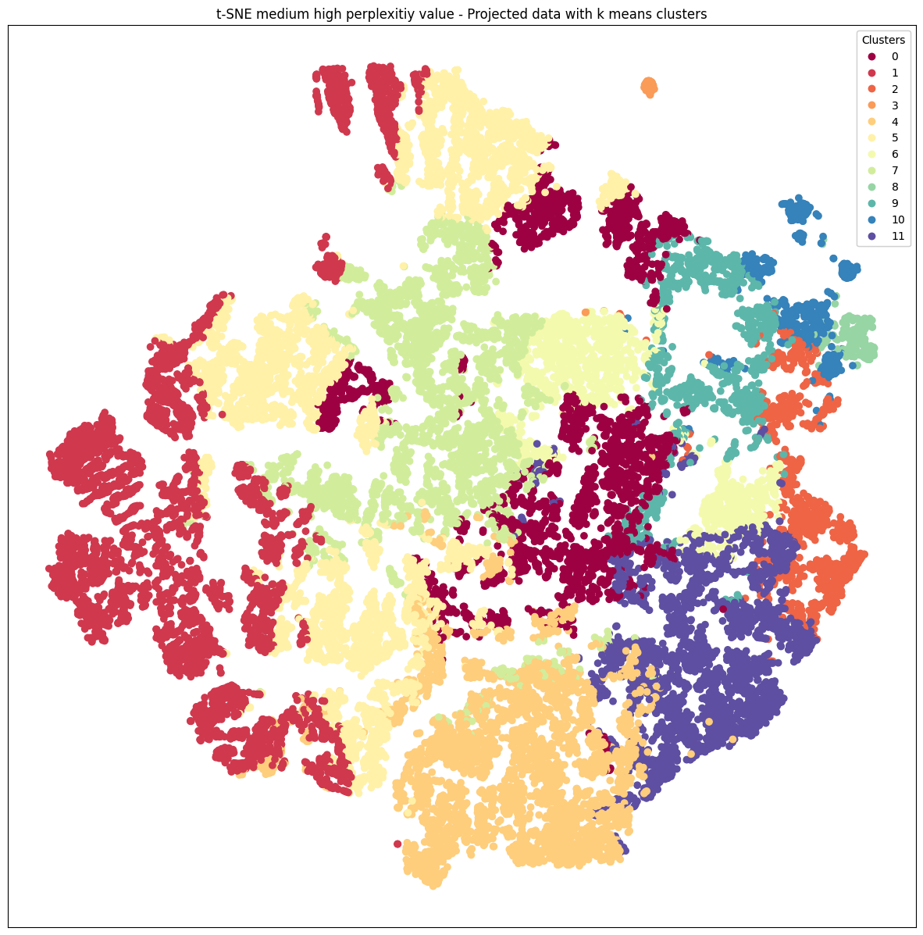
Result 2: Regardless of k in k means, we get two nicely segregated clusters in high-dimensional space (T-sne)

